Slide 1
Truck Platooning Autonomous Systems A Lab
(Group B)
Jasmeet Singh Matta
Moshiour Rahman Prince
Shihab Ud Doula

Slide 2
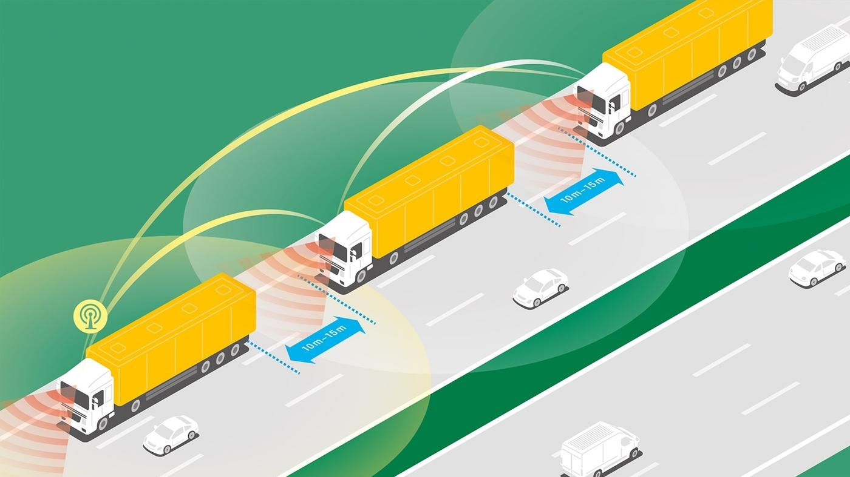
Introduction
Truck Platooning: Technique where multiple trucks drive in close formation, coordinated through communication systems.
Project Goal: Model, simulate, and validate truck platooning scenarios to improve fuel efficiency, safety, and traffic flow.

Slide 3
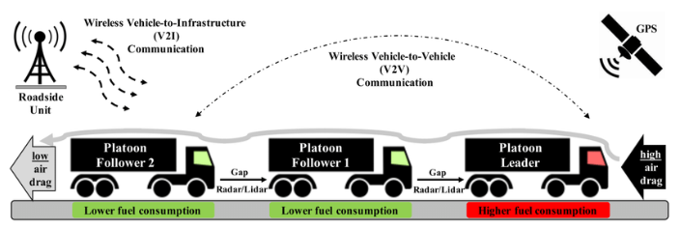
Motivation & Objective
Objectives:
Model critical driving scenarios.
Ensure system robustness and stability.
Integrate advanced modeling and real-time data processing.
Motivation:
Safety: Reduces accidents.
Efficiency: Lowers fuel consumption.
Traffic Flow: Optimizes road usage.

Slide 4
Identifying Key Scenarios
Scenarios Addressed:
Obstacle Avoidance: Detect and respond to obstacles.
Lane Changing and Steering: Manage lane changes and steering to prevent collisions.
Environmental Model: Simulate system behavior in various environmental conditions.

Slide 5
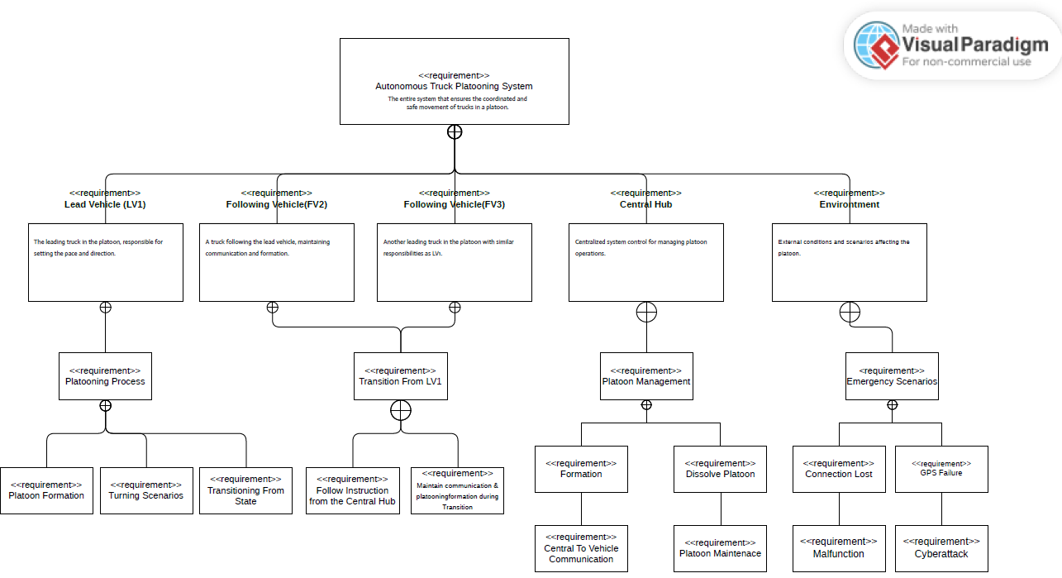
System Design with UML Diagrams
Requirement Diagram: Illustrates system components, including vehicles, central hub, and environment.

Slide 6
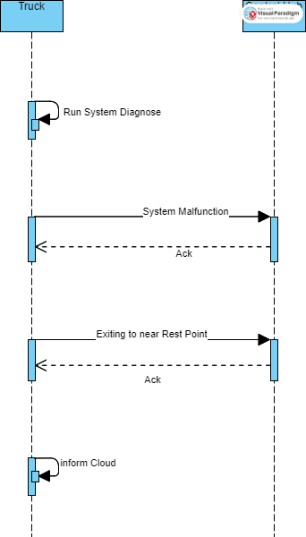
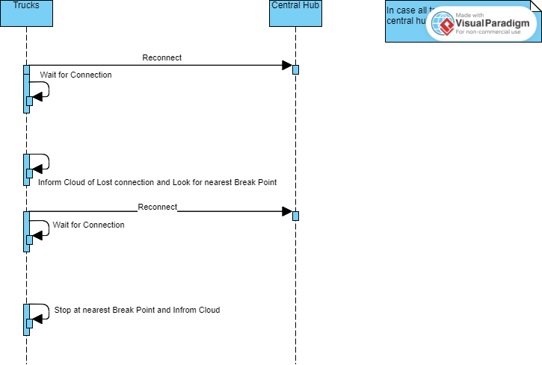
Sequence Diagram
Obstacle Avoidance: System diagnostics and handling of obstacles.
Figure:
Figure:

Slide 7
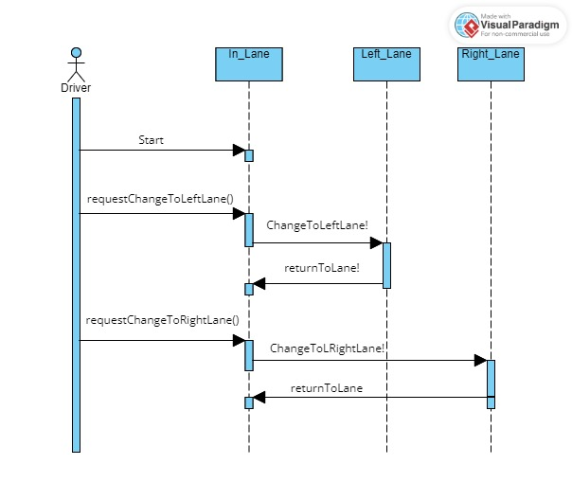
Lane Changing: Process for lane change requests and system responses.

Slide 8
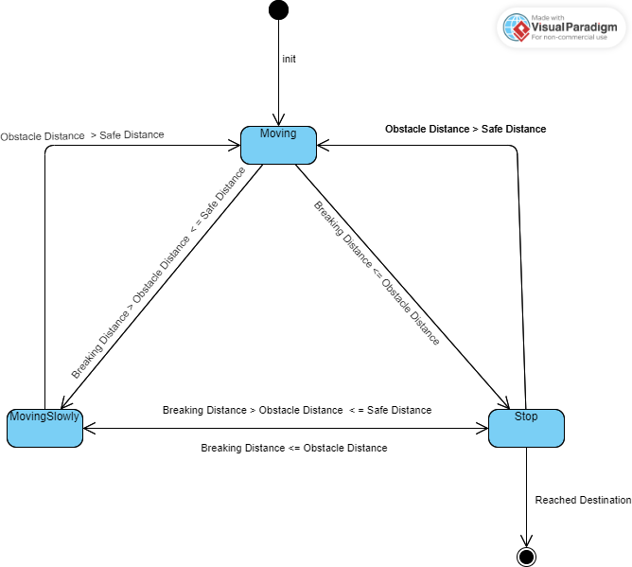
Obstacle Avoidance: State machine diagram for avoiding obstacle

Slide 9
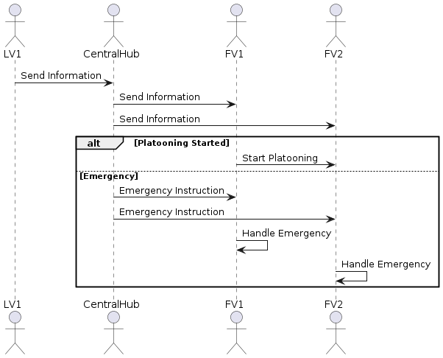
Environmental Model: Response to lost connections and emergencies.

Slide 10
Modeling Scenarios with UPPAAL
Obstacle Avoidance: Truck detects and responds to obstacles.
Lane Changing: Checks lane availability and executes lane changes safely.
Environment Model: Update Driving Requirement with respect to environmental changes
System Integration: Combines all scenarios into one cohesive model, ensuring dynamic responses.

Slide 11
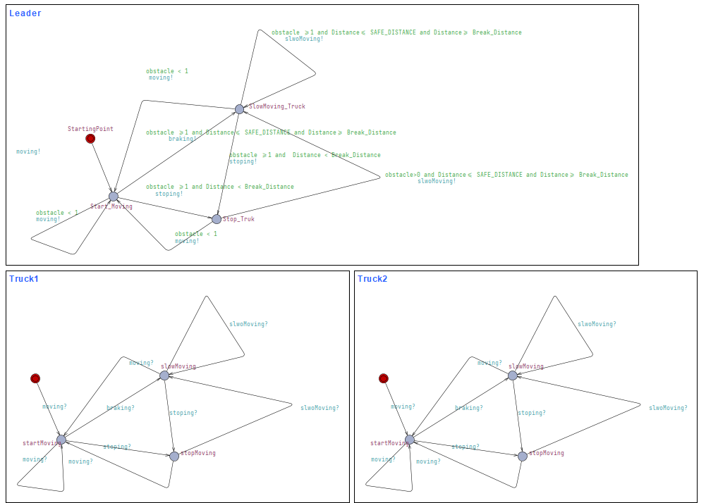
Obstacle Avoidance 1

Slide 12
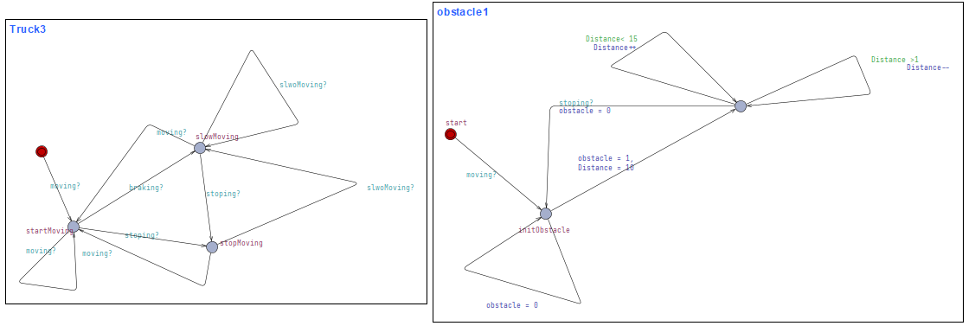
Obstacle Avoidance 2

Slide 13
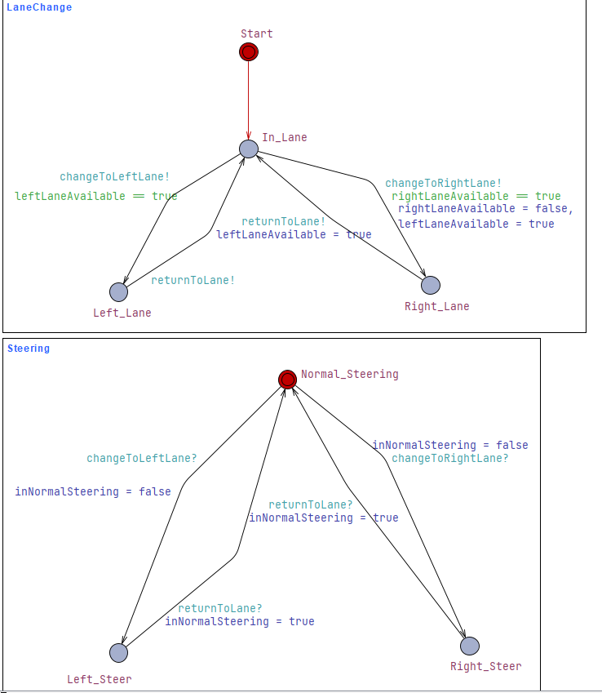
Lane Changing & Steering

Slide 14
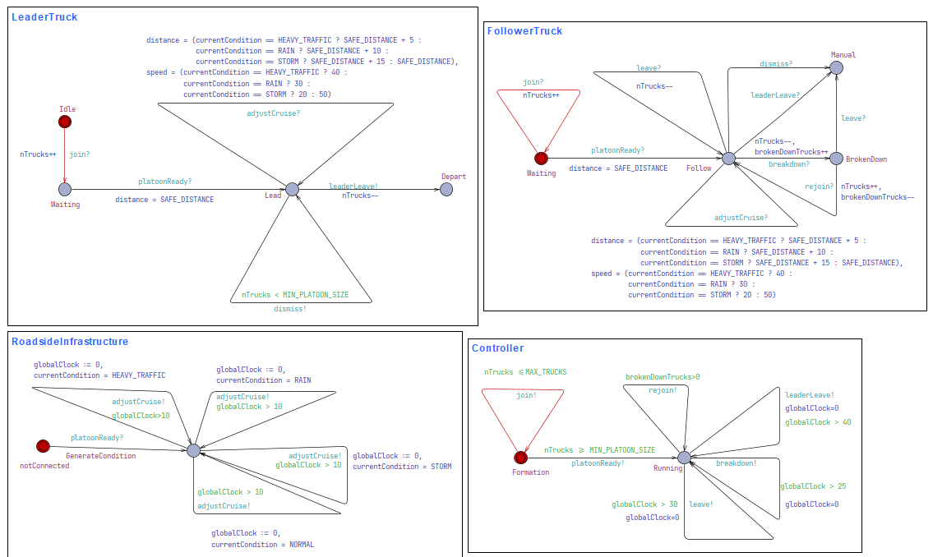
Environment Model

Slide 15
Decision Making with Machine Learning
Leader Vehicle Determination
Implemented a decision tree classifier using Scikit-learn.
Key Features: Route distance, route match, consumption, body characteristics, and equipment sensors.
Training: The dataset is split into training and testing sets, and the model is trained and visualized.

Slide 16
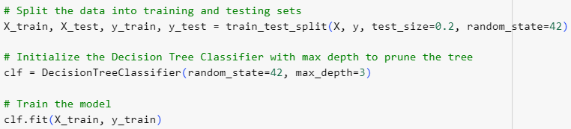
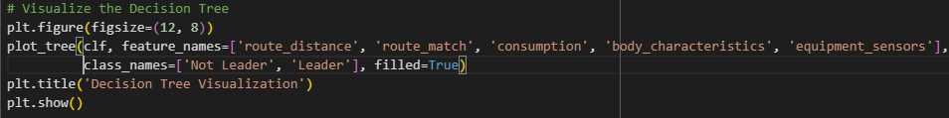

Slide 17
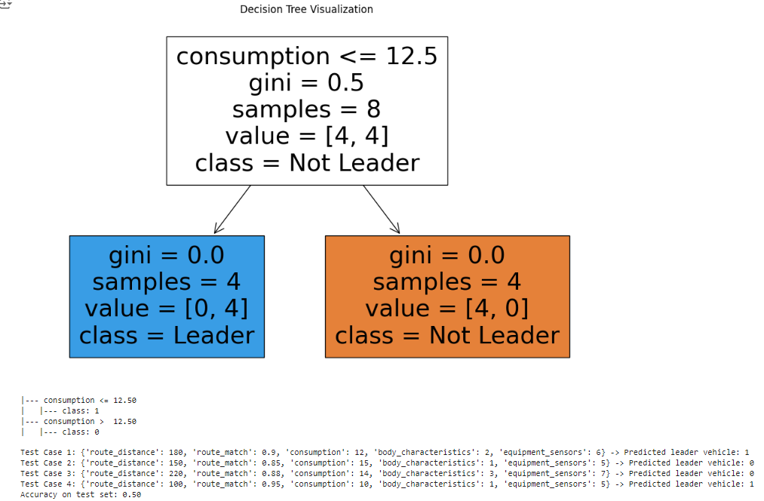
Leader Selection by Decision Tree

Slide 18

Simulation Environment (Python)
Development: Built a simulation environment to test scenarios and the learning algorithm.
Integration: Ensured synchronization of scenarios and the learning algorithm.
Tools: Implemented in Python for real-time data processing.

Slide 19
Video/code snippet

Slide 20
Conclusion and Future Work
Modeled and simulated key truck platooning scenarios
Demonstrated integration of UML, UPPAAL, and Python.
Future Work: Potential improvements include enhancing the learning algorithm and expanding the simulation environment.

Slide 21
References
Free Photo | Cupboards geometrical shapes collection. (2020, April 22). Freepik. https://www.freepik.com/free-photo/cupboards-geometrical-shapes-collection_7796098.htm
Milford, M. (2017, November 20). Coming soon to a highway near you—truck platooning. The Conversation. https://phys.org/news/2017-11-highway-youtruck-platooning.html
Truck platooning. (n.d.). Rapp AG. https://www.rapp.ch/de/stories/truck-platooning
Designing and Scheduling Cost-Efficient Tours by Using the Concept of Truck Platooning - Scientific Figure on ResearchGate. Available from: https://www.researchgate.net/figure/Basic-mechanisms-behind-the-concept-of-truck-platooning-based-on-Alam-2014-and-Janssen_fig1_338410373 [accessed 4 Jul, 2024]
Deng, Q. (2016). A General Simulation Framework for Modeling and Analysis of Heavy-Duty Vehicle Platooning. IEEE Transactions on Intelligent Transportation Systems, 17(11), 3252–3262. https://doi.org/10.1109/tits.2016.2548502

Slide 22

Questions?

